Slide 1
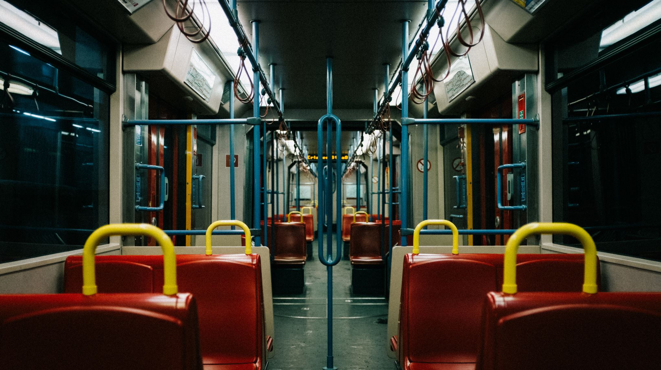
Singapore’s Land Public Transport
Chiam Joon Wee
P2222415
DAAA/FT/1B/05

Slide 2
Objectives
Accessibility of bus services
Analysis/Trend of bus services

Slide 3
Accessibility of bus services
AM/PM Peak Frequency, no. of services by Operator (bus_services.csv)
Distance between each bus stop by operator (bus_routes.csv)
Bus stops around Singapore (bus_stop.csv)

Slide 4
Nature of datasets
Bus_services
ServiceNo, Operator, Direction, Category, OriginCode, DestinationCode, AM_Peak_Freq, AM_Offpeak_Freq, PM_Peak_Freq, PM_Offpeak_Freq, LoopDesc
AM/PM frequency means how often a bus comes in the morning and noon
Category – trunk/ service
Operator – different operators SST GAS SMRT SBST
Bus_route
ServiceNo, Operator, Direction, StopSequence, BusStopCode, Distance, WD_FirstBus,WD_LastBus, SAT_FirstBus, SAT_LastBus, SUN_FirstBus, SUN_LastBus
Timing of first bus and last bus throughout the week.
Bus_stops
BusStopCode , RoadName, Description, Latitude, Longitude

Slide 5
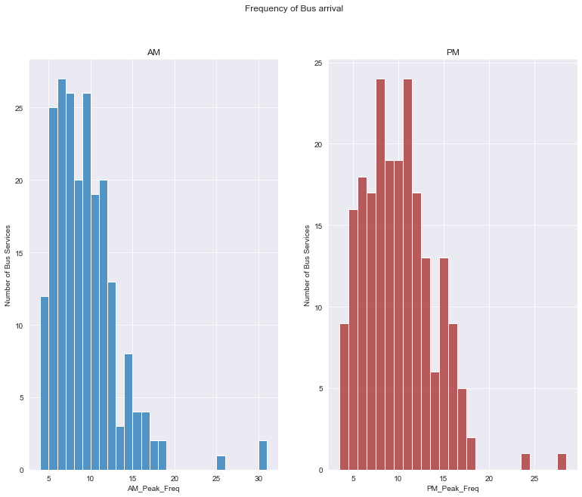
AM/PM Peak Frequency, no. of services by Operator (bus_services.csv)
This histogram shows the frequency of bus arrivals. By looking at the frequency of services during AM/PM peak , we can see that bus services come by the interval of every 7minutes in the morning and 9 minutes in the evening.

Slide 6
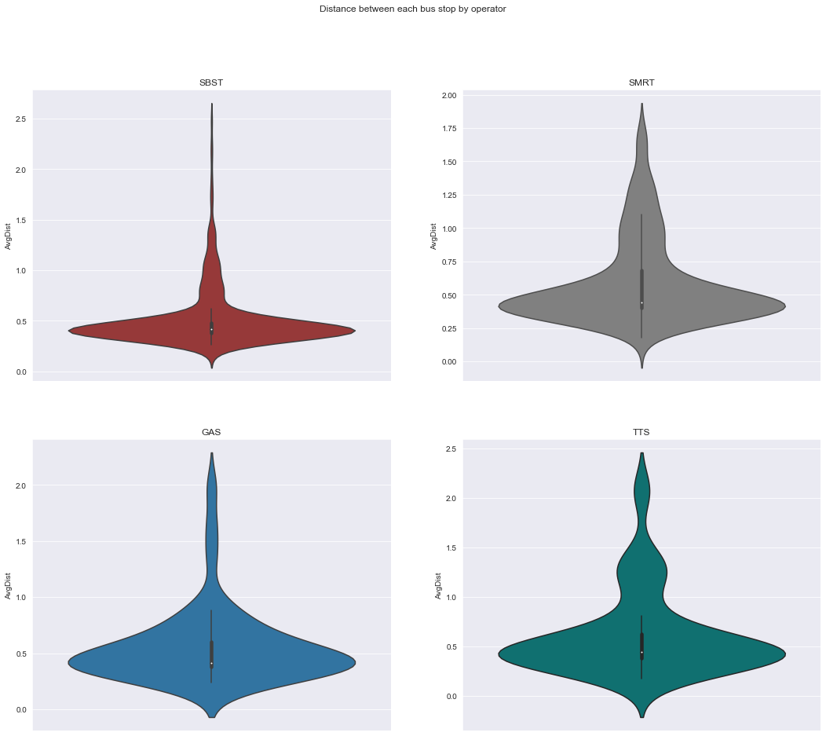
Distance between each bus stop by operator (bus_routes.csv)
The distance between each bus stop for each operator is mostly distributed within 0.4 km. This means that the bus stops are relatively near one another

Slide 7
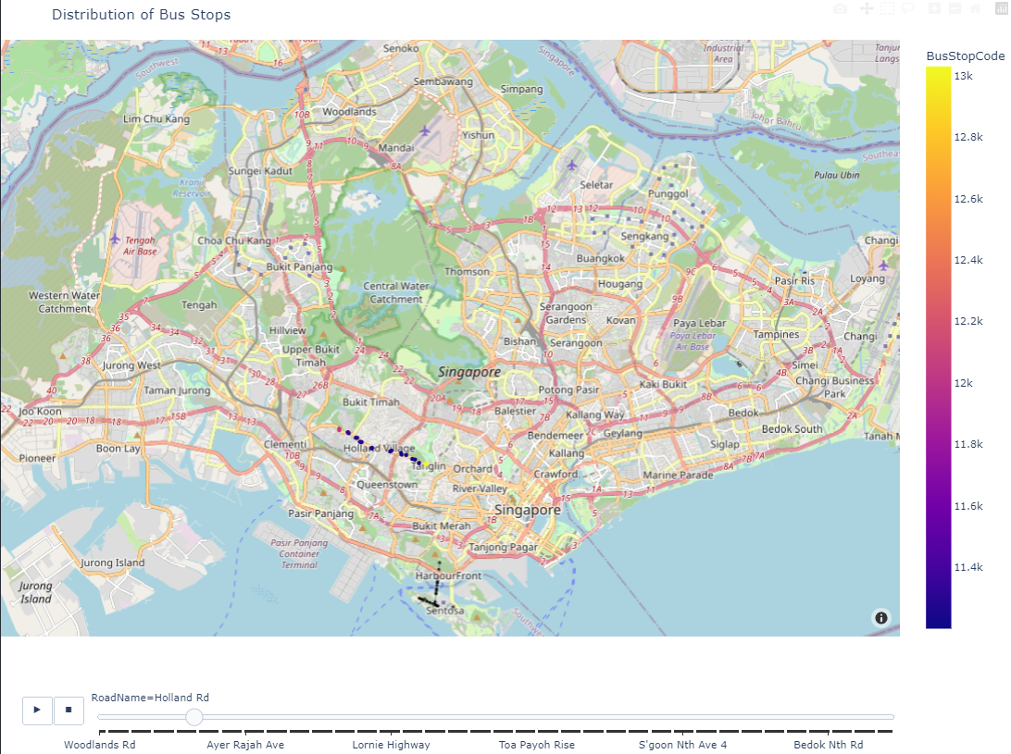
Distribution of Bus stops
The bus stops are distributed over Singapore, on the map I have a slider, it shows on that particular road Holland road, the different bus stop codes. As we can see there is actually a few bus stop available at that particular area. As the slider moves it shows the different bus stops all over Singapore. It actually is distributed all over Singapore. This shows that with bus services are easily accessible and we can go around Singapore conveniently.

Slide 8
Insights
With the bus frequency at 7 and 9 for AM and PM peak frequencies, being generally fast, we can get access to a bus and get to our destination relatively fast.
The average distance between each bus stop being an average of 0.4km. This means that the bus stops are relatively near one another. We can get access to a bus easily. There will always be bus stops near people as the distance is short. People don’t need to walk as far to get to a bus stop take a bus.
With bus stops available on different parts of Singapore (differentiated by road name), we are able to travel to that part of Singapore.

Slide 9
Analysis/Trend of bus services
Distribution of distance travelled by each operator including all bus services (bus_routes.csv)
Comparing the variables such as bus frequency, services, operator and distance, whether they have correlation. (bus_routes.csv + bus_services.csv)
Bus services and ridership over the years (annual-bus-population-by-passenger-capacity.csv and yearly-ave-daily-pt-ridership.csv)

Slide 10
Nature of datasets
Yearly-ave-daily-pt-ridership
Year, Mode, Ridership
Annual-bus-population-by-passenger-capacity
Year, Capacity, number of buses
Links to the dataset :
https://data.gov.sg/dataset/annual-age-bus-population-by-passenger-capacity
https://data.gov.sg/dataset/public-transport-utilisation-average-public-transport-ridership?view_id=3619b55d-d1c2-4891-8b43-97b192bcb0c4&resource_id=552b8662-3cbc-48c0-9fbb-abdc07fb377a

Slide 11
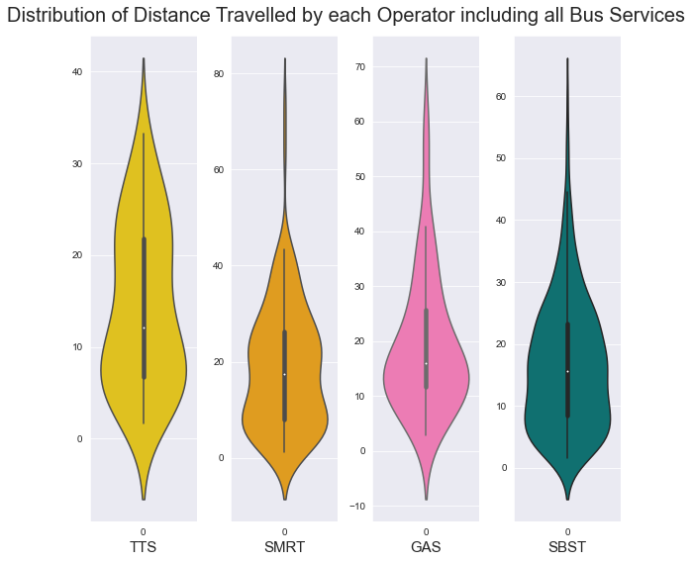
Distribution of distance travelled by each operator including all bus services
This violin plot shows the distance travelled by each operator. Looking at the violin plot, it shows that the mean distance of 15km travelled by each operator. We can also see that SMRT services travel the most distance compared to the other bus services.

Slide 12
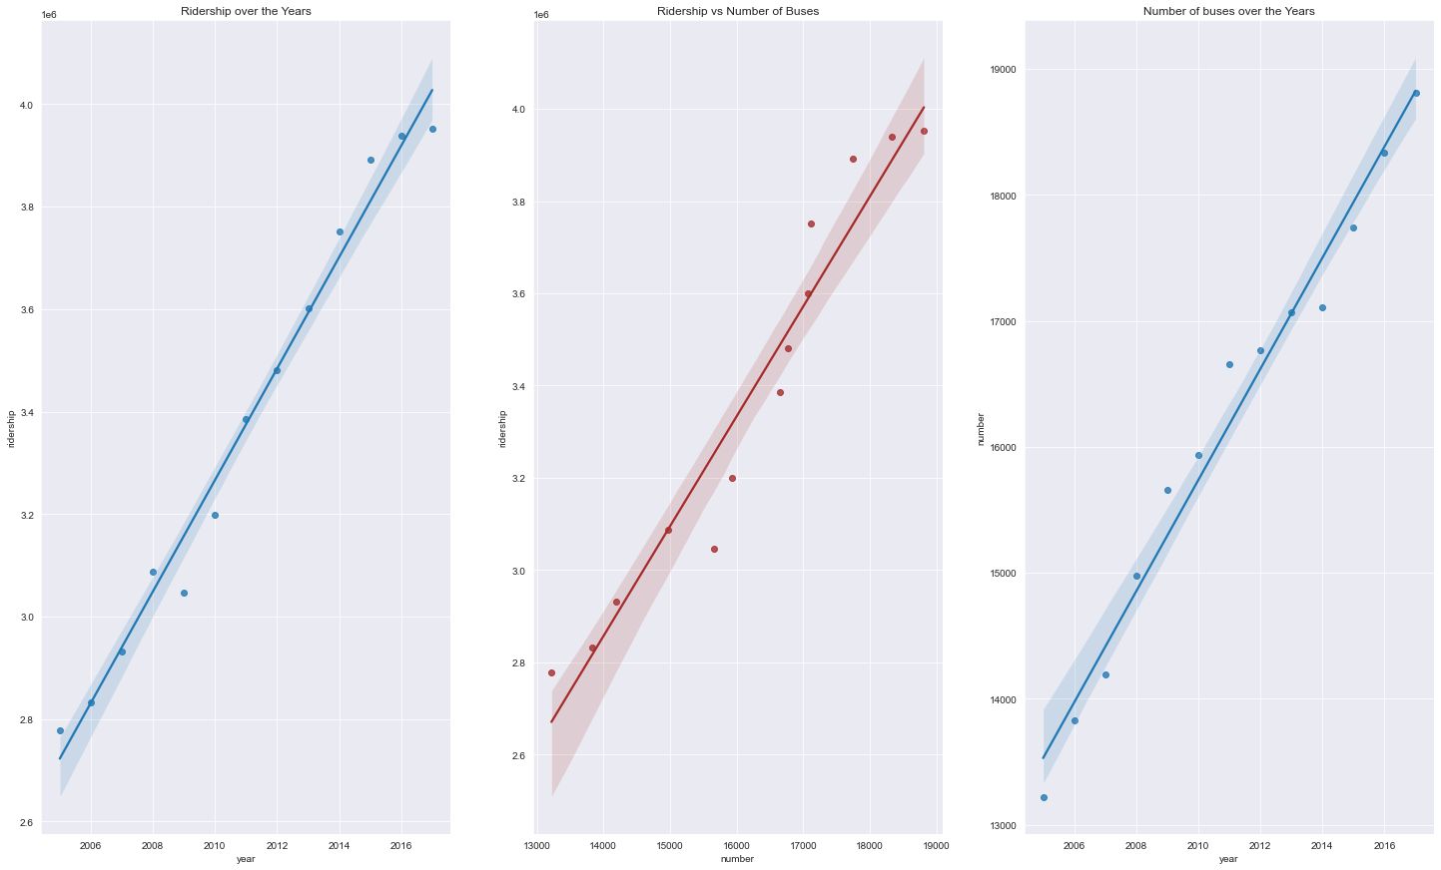
Bus services and ridership over the years
We can see the ridership over the years increase and the number of buses over the years increase. The middle regression plot that as the number of buses increase, the amount of ridership increase.

Slide 13
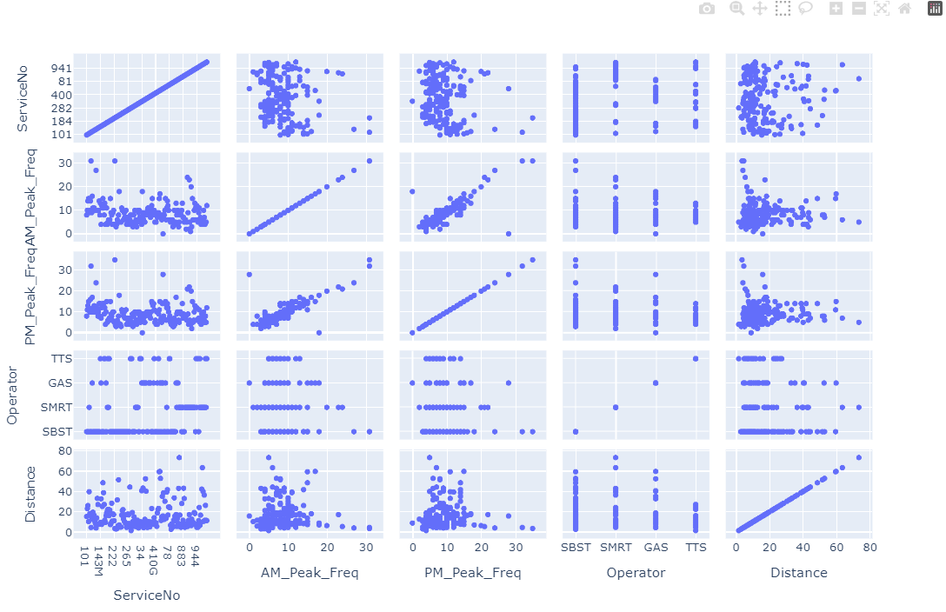
Comparing the variables such as bus frequency, services, operator and distance
On the right, it is a pairplot with all the variable after I wrangled the data. The objective is to see the trends between Distance, Operator, PM and AM Peak Frequency and Service Number. We can actually see that the distance the bus travelled does not actually affect the AM and PM Peak Frequency. There’s not really a specific and direct trend here.

Slide 14
Insights
With any operator you take, you are able to travel 15km on the average. The amount of distance travelled by the operators differs following the ranking of SMRT, GAS, SBST, TTS.
The number of buses increase over the years, together with the amount of ridership also increases. The regplot in the middle shows that actually when the number of buses increase, the ridership increases as well.
We can see that the bus services offered are able to take us to places and there are not specific relationship. For example if we were to take a bus that travels for 10.5km, that bus may have a frequency of 7, meaning arriving every 7 minutes. Another bus might travel for 10.7km and have a frequency of 15, meaning arriving every 15mintues. Showing no correlation.

Slide 15
Recommendations
I suggest that the bus frequency during peak hours could be slightly faster from a 7 minutes in the morning to a 5 minutes frequency
In the future, the arrival of buses that travel long distances could be have a higher frequency.

